Slide 1
BOT323
MINERAL NUTRITION

Slide 2
INTRODUCTION
MINERAL NUTRIENTS ARE ELEMENTS acquired primarily in the form of inorganic ions from the soil.
Only way of entry of minerals in biosphere is through the roots of the plants.
After absorption mineral nutrient are transported to various locations in the plants where they are utilized in different processes.
The study of how plants obtain and use mineral nutrients is called MINERAL NUTRITION.

Slide 3
About 60 different elements have been reported in plants out of which 30 are present in all plants.
Out of 30, 16 elements are essential and rest are non-essential.
This essentiality and non-essentiality of the mineral elements is governed by CRITERIA OF ESSENTIALITY.

Slide 4
CRITERIA OF ESSENTIALITY
Given by Arnon and Stout in 1939.
It states that
  A plant must be unable to grow in the absence of essential elements.
  It must be irreplaceable, i.e. specific for a particular plant function.
  It must be directly involved in the nutrition of the plants.

Slide 5
Essential mineral elements are usually classified as macronutrients or micronutrients, according to their relative concentration in plant tissue.
Macronutrients
    Required by plants in larger quantities
    C, H, O, N, P, K, S, Ca, Mg, Fe
Micronutrients
    Required in small amounts
    Cu, Zn, Mn, Mo, B, Cl

Slide 6
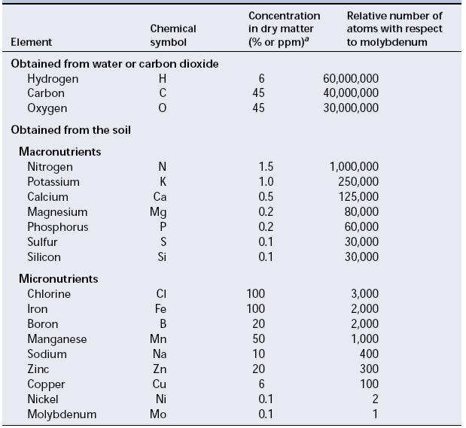
Table: Adequate tissue levels of elements that may be required by the plants.

Slide 7
The classification into macro and micronutrients is difficult to justify.
Hence they must be classified based on their biological role and physiological function.
Hence plant nutrients can be divided into four basic groups:
  The first group of essential elements forms the organic (carbon) compounds of the plant. Plants assimilate these nutrients via biochemical reactions involving oxidation and reduction.

Slide 8
  The second group is important in energy storage reactions or in maintaining structural integrity.
  The third group is present in plant tissue as either free ions or ions bound to substances such as the pectic acids present in the plant cell wall.
  The fourth group has important roles in reactions involving electron transfer.

Slide 9
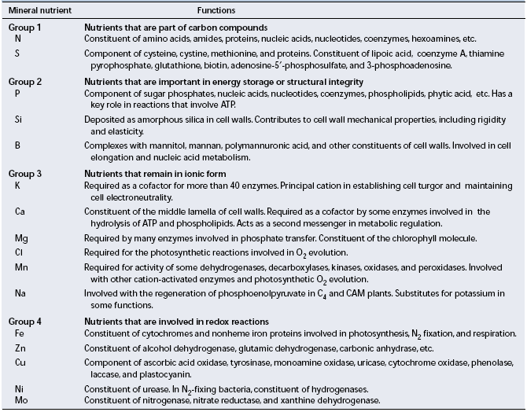

Slide 10
CHLOROSIS

Slide 11
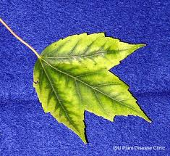

Slide 12
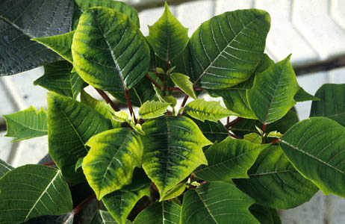

Slide 13
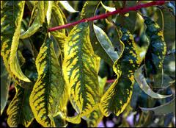

Slide 14
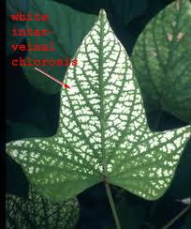

Slide 15
NECROSIS

Slide 16
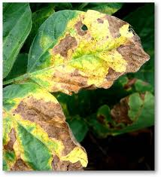

Slide 17
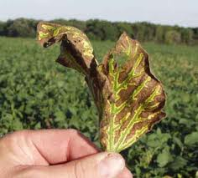

Slide 18
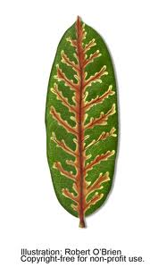

Slide 19
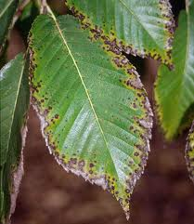

Slide 20
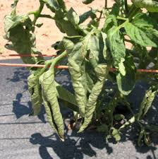

Slide 21
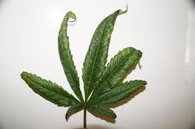

Slide 22
DEFICIENCIES OF GROUP 1 MINERAL ELEMENTS
Nitrogen
    Required in greatest amount
    Important for amino and nucleic acids
    Deficiency inhibits plant growth
    Severe deficiency can cause chlorosis and ultimately leaves die
Sulfur
    Found in two amino acids and essential for metabolism
    Symptoms include chlorosis, stunting of growth and anthocyanin accumulation
    Chlorosis generally occur throughout the plant

Slide 23
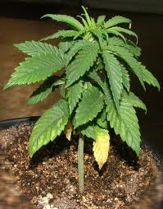

Slide 24
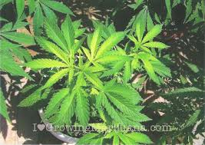

Slide 25
DEFICIENCIES OF GROUP 2 MINERAL ELEMENTS
Phopshorus
    Characteristic symptoms of phosphorus deficiency include stunted growth in young plants
    Dark green coloration of the leaves, which may be malformed and
    Contain small spots of dead tissue called necrotic spots
    Also include production of slender stem and death of older leaves.

Slide 26
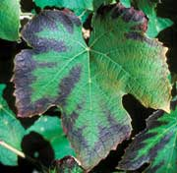

Slide 27
Silicon
    Plants deficient in silicon are more susceptible to lodging (falling over) and fungal infection.
    It also forms complexes with polyphenols and thus serves as an alternative to lignin in the reinforcement of cell walls.
    In addition, silicon can ameliorate the toxicity of many heavy metals.
Boron
    A characteristic symptom is black necrosis of the young leaves and terminal buds.
    Stems may be unusually stiff or brittle.
    Apical dominance may be lost.
    Structures such as fruits and tubers exhibit necrosis.

Slide 28
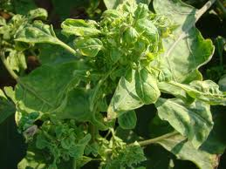

Slide 29
DEFICIENCIES OF GROUP 3 MINERAL ELEMENTS
Potassium
    Marginal chlorosis
    Dying of leaf tip
    Appear at mature leaves
    Stem is slender and weak with abnormally short internodes.
Calcium
    Necrosis of young meristamatic regions
    Downward hooking of young leaves
    Root system appear brownish, short, and highly branched.
    Severe stunting may result.

Slide 30
Magnesium
    Chlorosis between leaf veins.
    Leaves may become yellow or white.
    It may also lead to premature abscession.
Chlorine
    Required in oxygen evolution in photosynthesis.
    Deficiency starts with wilting of leaf tip and proceeds to general necrosis of leaves.
    Leaf growth is reduced.
    Leaves appear bronze in color.
    Roots of chlorine deficient plants are stunted.

Slide 31
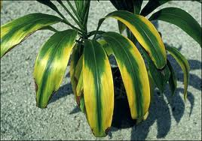

Slide 32
Manganese
    Main symptom is intervenous chlorosis associated with development of small necrotic spots.
Sodium
    C4 and CAM plants require Na ions.
    Required for regeneration of PEP.
    Under Na deficiency flowering fail to occur in these plants.

Slide 33
DEFICIENCY OF GROUP 4 MINERAL ELEMENTS
Iron
    Intervenous chlorosis in younger leaves.
    After some time leaf starts to turn white.
Zinc
    Reduction in internodal growth.
    Plant shows rosette habit of growth.
    Leaves are small and distorted.
    Leaf margins usually have a puckered appearance.

Slide 34
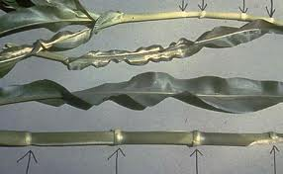

Slide 35
Copper
    Also involve in electron transfer reactions eg. Plastocyanin.
    Initial symptom of Cu deficiency is production of dark green leaves with development of necrotic spots.
    Necrotic spots generally spread along margins.
    Leaves also appear twisted and malformed.
    Premature abscision of leaves may occur.
Nickel
    Nickel deficiency in plants leads to accumulation of user in their leaves.
    Leaf tip necrosis is also observed.

Slide 36
Molybdenum
    The first indication of a molybdenum deficiency is general chlorosis between veins and necrosis of the older leaves.
    Molybdenum deficiency can also lead to nitrogen deficiency.

Slide 37
